Slide 1
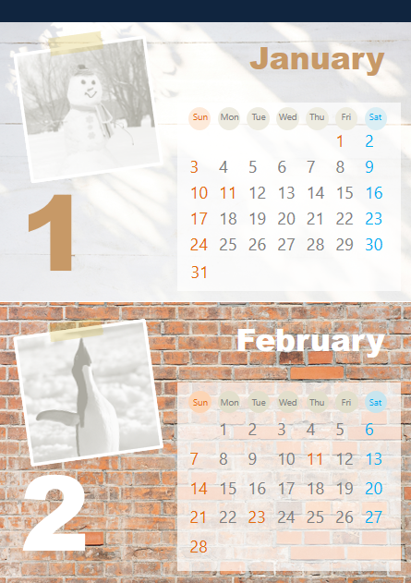

1
2
1
1.写真の挿入
サンプル写真内の画像アイコンをクリックすると「ライブラリ」から好きな写真を挿入することができます。
2.テキストの入れ替え
テキストを自由に入れ替えることができます。
印刷のポイント
フチなし全面印刷がおすすめです。

Slide 2
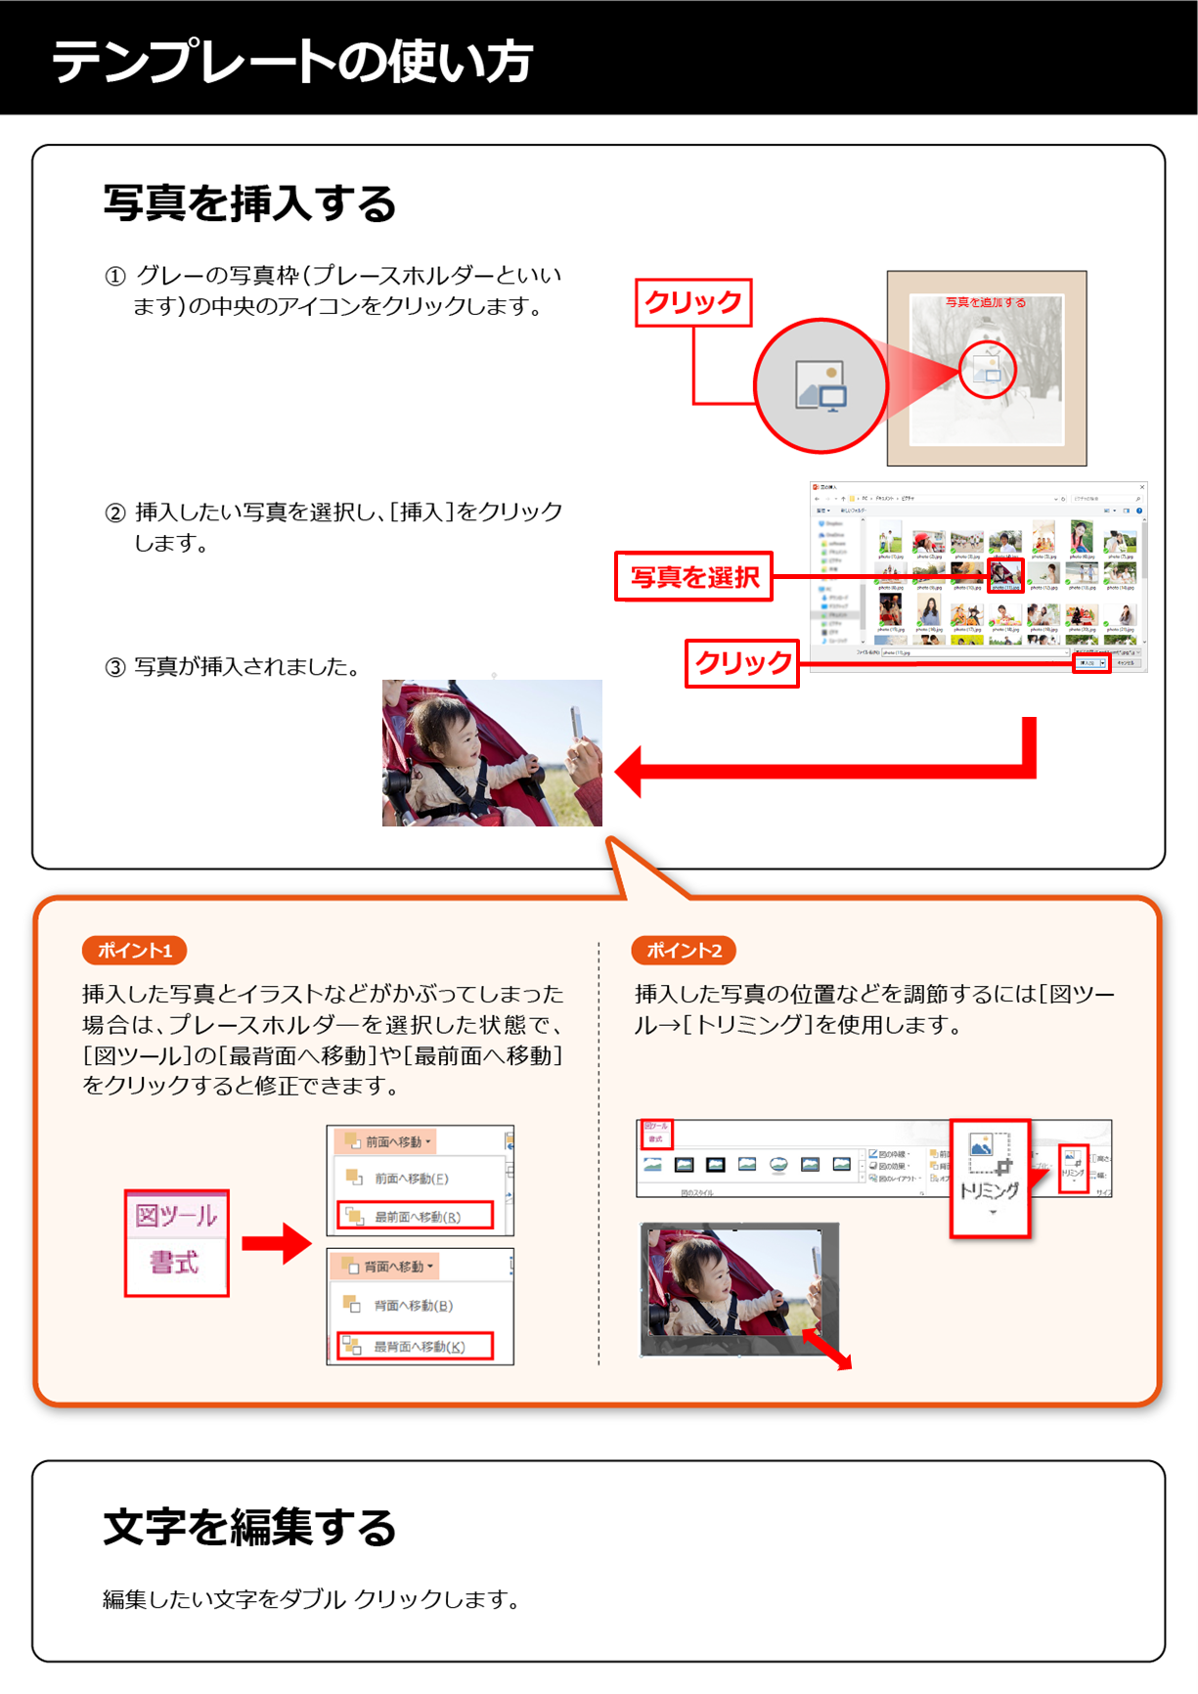

Slide 3


January
Sun | Mon | Tue | Wed | Thu | Fri | Sat
 |  |  |  |  | 1 | 2
3 | 4 | 5 | 6 | 7 | 8 | 9
10 | 11 | 12 | 13 | 14 | 15 | 16
17 | 18 | 19 | 20 | 21 | 22 | 23
24 | 25 | 26 | 27 | 28 | 29 | 30
31
1
February
Sun | Mon | Tue | Wed | Thu | Fri | Sat
 | 1 | 2 | 3 | 4 | 5 | 6
7 | 8 | 9 | 10 | 11 | 12 | 13
14 | 15 | 16 | 17 | 18 | 19 | 20
21 | 22 | 23 | 24 | 25 | 26 | 27
28
2

Slide 4
March
Sun | Mon | Tue | Wed | Thu | Fri | Sat
 | 1 | 2 | 3 | 4 | 5 | 6
7 | 8 | 9 | 10 | 11 | 12 | 13
14 | 15 | 16 | 17 | 18 | 19 | 20
21 | 22 | 23 | 24 | 25 | 26 | 27
28 | 29 | 30 | 31
3
April
Sun | Mon | Tue | Wed | Thu | Fri | Sat
 |  |  |  | 1 | 2 | 3
4 | 5 | 6 | 7 | 8 | 9 | 10
11 | 12 | 13 | 14 | 15 | 16 | 17
18 | 19 | 20 | 21 | 22 | 23 | 24
25 | 26 | 27 | 28 | 29 | 30
4

Slide 5
May
Sun | Mon | Tue | Wed | Thu | Fri | Sat
 |  |  |  |  |  | 1
2 | 3 | 4 | 5 | 6 | 7 | 8
9 | 10 | 11 | 12 | 13 | 14 | 15
16 | 17 | 18 | 19 | 20 | 21 | 22
23 30 | 24 31 | 25 | 26 | 27 | 28 | 29
5
June
Sun | Mon | Tue | Wed | Thu | Fri | Sat
 |  | 1 | 2 | 3 | 4 | 5
6 | 7 | 8 | 9 | 10 | 11 | 12
13 | 14 | 15 | 16 | 17 | 18 | 19
20 | 21 | 22 | 23 | 24 | 25 | 26
27 | 28 | 29 | 30
6

Slide 6
July
Sun | Mon | Tue | Wed | Thu | Fri | Sat
 |  |  |  | 1 | 2 | 3
4 | 5 | 6 | 7 | 8 | 9 | 10
11 | 12 | 13 | 14 | 15 | 16 | 17
18 | 19 | 20 | 21 | 22 | 23 | 24
25 | 26 | 27 | 28 | 29 | 30 | 31
7
August
Sun | Mon | Tue | Wed | Thu | Fri | Sat
1 | 2 | 3 | 4 | 5 | 6 | 7
8 | 9 | 10 | 11 | 12 | 13 | 14
15 | 16 | 17 | 18 | 19 | 20 | 21
22 | 23 | 24 | 25 | 26 | 27 | 28
29 | 30 | 31
8

Slide 7
September
Sun | Mon | Tue | Wed | Thu | Fri | Sat
 |  |  | 1 | 2 | 3 | 4
5 | 6 | 7 | 8 | 9 | 10 | 11
12 | 13 | 14 | 15 | 16 | 17 | 18
19 | 20 | 21 | 22 | 23 | 24 | 25
26 | 27 | 28 | 29 | 30
9
October
Sun | Mon | Tue | Wed | Thu | Fri | Sat
 |  |  |  |  | 1 | 2
3 | 4 | 5 | 6 | 7 | 8 | 9
10 | 11 | 12 | 13 | 14 | 15 | 16
17 | 18 | 19 | 20 | 21 | 22 | 23
24 31 | 25 | 26 | 27 | 28 | 29 | 30
10

Slide 8
November
Sun | Mon | Tue | Wed | Thu | Fri | Sat
 | 1 | 2 | 3 | 4 | 5 | 6
7 | 8 | 9 | 10 | 11 | 12 | 13
14 | 15 | 16 | 17 | 18 | 19 | 20
21 | 22 | 23 | 24 | 25 | 26 | 27
28 | 29 | 30
11
December
Sun | Mon | Tue | Wed | Thu | Fri | Sat
 |  |  | 1 | 2 | 3 | 4
5 | 6 | 7 | 8 | 9 | 10 | 11
12 | 13 | 14 | 15 | 16 | 17 | 18
19 | 20 | 21 | 22 | 23 | 24 | 25
26 | 27 | 28 | 29 | 30 | 31
12

